Slide 1
Virtualization
UBMS Stem Experience: Jurassic Park
Notes:
Play this first: https://www.youtube.com/watch?v=GeXwR32GCOw&ab_channel=GnosysNetworks

Slide 2
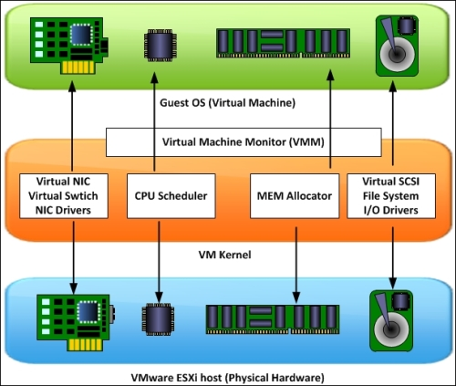
VMWare Resource Allocation
VM’s are virtual copies of a real PC
They have virtual CPU, RAM, NICs, etc
They have virtual storage, an Operating system, USB, etc
When a VM is created, its components are defined and mapped to real hardware
Resources are reserved (pre-allocated) or set to a limit (maximum amount)
Resources can be overcommitted but shouldn’t be (risk if everything maxes out at once)

Slide 3
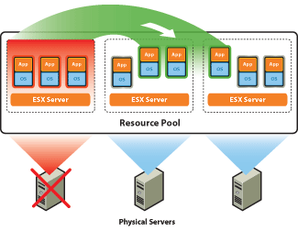
VMWare Redundancy
If a host in a cluster goes down, the VM’s tied to that host can migrate to other hosts
This requires a shared storage between the hosts
Also assumes other hosts have resources free to handle new loads

Slide 4
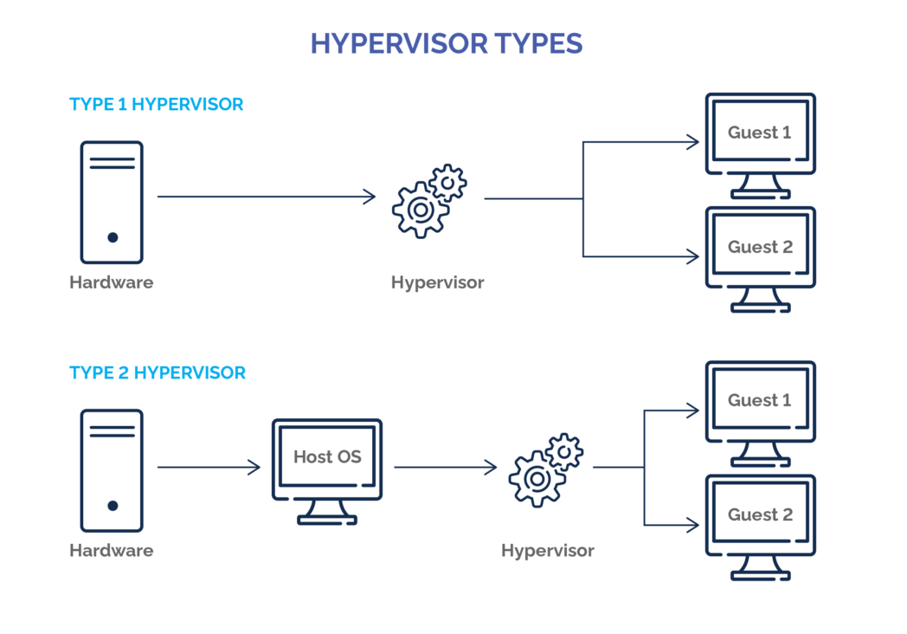
Hypervisor Types

Slide 5

